Slide 1
Underwater Network Simulation on Unet Sim

Slide 2
UnetSIM Basics
Network simulator that enables a network engineer to simulate an entire underwater network on a single computer
Allows UnetStack agents and protocols to be simulated in realistic channel conditions, with minimal efforts.
Unet nodes run the UnetStack software that allows us to effectively communicate over all types of links using a common Application Programming Interface (API).
UnetStack API bindings are available for several languages including Java, Groovy, Python, Julia, C, Javascript, etc

Slide 3
UnetStack Services
1. Node Information: They manage and maintain node’s attributes
2. Address Regulation: Used to manage address requests
3. Datagram: Support transmission and reception of messages
4. Physical: Used to send transmission frames
5. Ranging: Provide nodes with time synchronisation
6. Link: Provide the nodes with single-hop communication

Slide 4
UnetStack Services (Continued)
7. Medium Access Control (MAC): Used to make the system more reliable in terms of sending acknowledgement messages
8. Routing: Provide nodes with multi-hop communication
9. Route Maintenance: Generate routing notifications to keep a log of routes in terms of routing tables
10. Transport: Provides services such as end to end reliability for large datagrams
11. Remote Access: Agents having remote access provide control over nodes
12. State Persistence: Save the logs or scripts of the present state

Slide 5
Power Distance Analysis
Water is a significantly lossy medium and the attenuation depends upon the channel parameters.
On top of this, noise present in the channel due to various sources such as marine animals, ships, shorelines further diminish the strength of the signal
Hence, we require a certain minimum power level to transmit a packet to avoid packet loss.
Objective: To find the minimum power required to transmit a packet without any loss

Slide 6
Power Distance Analysis
Channel Model
Model: Basic Acoustic Channel
Carrier Frequency: 30 kHz,
Bandwidth: 10000 Hz,
Spreading Loss Factor: 2 (Spherical or Cylindrical)
Temperature: 15 C
Salinity: 35 ppt
Noise Level: 40 dB
Water Depth: 1000 m

Slide 7
Power DIstance Analysis
Simulation
Node A: Location = [0.m, 0.m, -100.m]
Node B: Location = [x.m, 0.m, -100.m]
To vary the distance we vary x.
Simulation Time = 2 hrs
loss = trace.txCount ? 100*trace.dropCount/trace.txCount : 0

Slide 8
Power DIstance Analysis
Results
Method 1: For a given power level, what is the maximum distance to which we can transmit packets without any loss?
Done for a power level of -40 dB
For a distance up to 400 m, we recorded no packet loss.
Thereafter, as we increased the distance, the loss % increased in an almost linear manner
At 780 m, the packet loss was 100 % i.e. no packet transmitted was received.
Beyond 780m, the packet loss remained 100%

Slide 9
Power Distance Analysis
Results
Method 2: For a certain distance, what is the minimum level of power that we require so as to avoid packet loss?
Distance | Minimum Power Required
100 m | -56 dB
200 m | -53 dB
300 m | -51 dB
400 m | -50 dB
500 m | -49 dB

Slide 10
Time Distance Analysis
Channel Model
Model: Basic Acoustic Channel
Carrier Frequency: 30 kHz,
Bandwidth: 10000 Hz,
Spreading Loss Factor: 2 (Spherical or Cylindrical)
Temperature: 15 C
Salinity: 35 ppt
Noise Level: 40 dB
Water Depth: 1000 m
Bit Rate: 2400 bps

Slide 11
Time Distance Analysis
Simulation
Node A: Location = [0.m, 0.m, -100.m]
Node B: Location = [x.m, 0.m, -100.m]
To vary the distance we vary x.
Following observations were made:
A constant time is required for non-deterministic processes.
The time delay linearly increases with distance underwater.

Slide 12
Results
Distance (m) | Distance/Speed (s) | Size/Bit Rate (s) | Non-Deterministic Delay (s) | Total Delay
50 | 0.033 | 0.125 | 1.075 | 1.233
100 | 0.067 | 0.125 | 1.075 | 1.267
150 | 0.100 | 0.125 | 1.075 | 1.300
200 | 0.133 | 0.125 | 1.075 | 1.333
250 | 0.167 | 0.125 | 1.075 | 1.367
300 | 0.200 | 0.125 | 1.075 | 1.400
350 | 0.233 | 0.125 | 1.075 | 1.433
400 | 0.267 | 0.125 | 1.075 | 1.467
450 | 0.300 | 0.125 | 1.075 | 1.500
500 | 0.333 | 0.125 | 1.075 | 1.533

Slide 13
Multihop Transmission
Node 21: tcp://localhost:1121, http://localhost:8021/
Node 22: tcp://localhost:1122, http://localhost:8022/
Node 27: tcp://localhost:1127, http://localhost:8027/
Node 28: tcp://localhost:1128, http://localhost:8028/
Node 29: tcp://localhost:1129, http://localhost:8029/
Node 31: tcp://localhost:1131, http://localhost:8031/
Node 34: tcp://localhost:1134, http://localhost:8034/

Slide 14
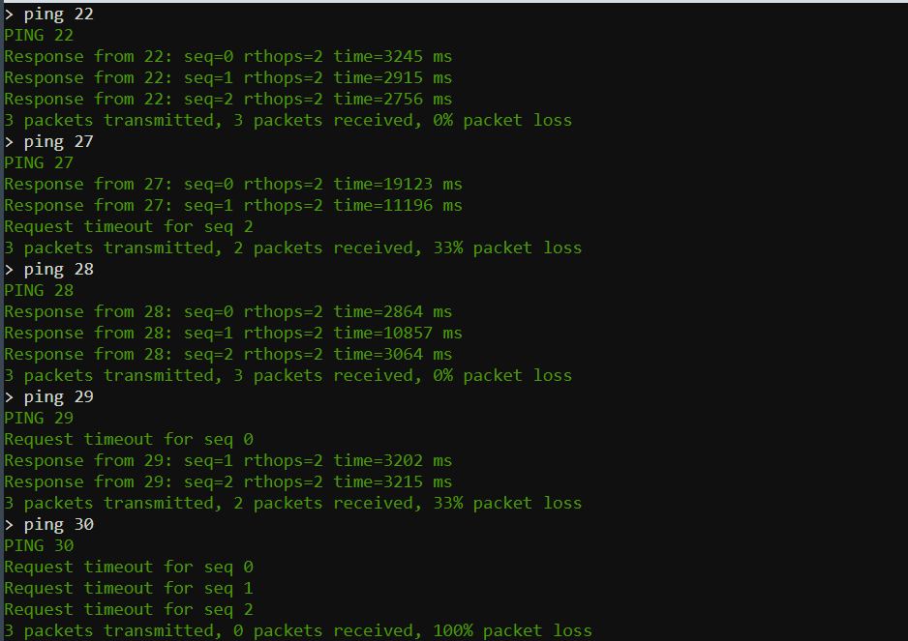

Slide 15
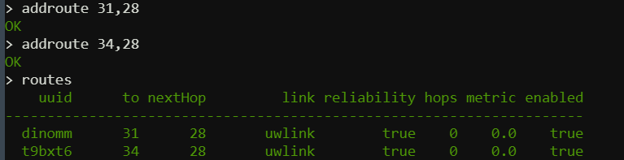

Slide 16
Node Mobility
Mobile Node (MN), or sometimes a subnet, changing its point of attachment to the network while its communication to the network remains uninterrupted.
Mobility reduces energy consumption and provides better monitoring of ongoing events in sensed fields.
The mobility of the nodes is set to false to indicate that the nodes are static and it set to true if the nodes are mobile.

Slide 17
Properties & Parameters
Address
Web: TCP/IP port number for web interface
Shell
Api: TCP/IP port number for the API port
Location
Mobility
Heading :Initial heading of the node
Speed — speed in m/s, if mobile node
Heading — heading in degrees, 0 is North, measured clockwise, if mobile node
turnRate — turn rate in degrees/s, measured clockwise, if mobile node
diveRate — dive rate in m/s, if it’s a mobile node

Slide 18
Simulation - Circular mobility:
simulate {
def n1 = node 'AUV-1', location: [0, 0, 0], mobility: false
n1.motionModel = [speed: 5.mps, turnRate: 1.dps]
def n3 = node 'AUV-3', location: [60, 0, 0], mobility: false
def n2 = node 'AUV-2', location: [0, 0, 0], mobility: true
n2.motionModel = [speed: 5.mps, turnRate: 10.dps] #radius=28.64

Slide 19
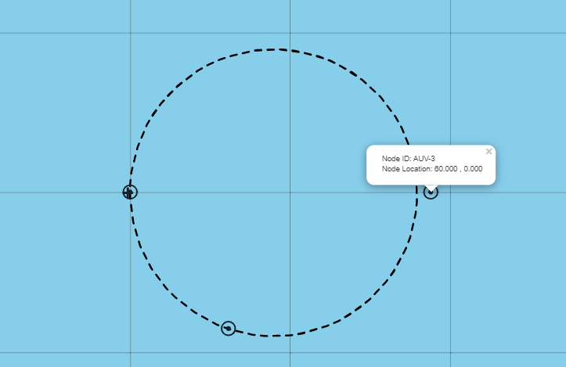

Slide 20
Simulation - Vertical mobility:
def C = node 'C', address: 31, location: [80.m, 0, -600.m]
def D = node 'D', address: 32, location: [-80.m, 0, -600.m]
def E = node 'E', address: 33, location: [50.m, 0, -1200.m]
def F = node 'F', address: 34, location: [-50.m, 0, -1200.m]
def B = node 'B', address: 21, location: [0, 0, 0], mobility: true
B.motionModel = [
[duration: 3.minutes, diveRate: 10.mps],
[duration: 3.minutes, diveRate: -10.mps],
[time: 6.minutes, turnRate: 0.dps, diveRate: 0.mps],
]

Slide 21
